Slide 1
Abstract Class and Interface By Gitanjali More

Slide 2
Abstraction in Java
Abstraction is a process of hiding the implementation details and showing only functionality to the user
Another way, it shows only essential things to the user and hides the internal details, for example, sending SMS where we type the text and send the message. We do not know the internal processing about the message delivery
Ways to achieve Abstraction
There are two ways to achieve abstraction in Java:
Using Abstract Class (0 to 100%)
Using Interface (100%)

Slide 3
Points to Remember
An abstract class must be declared with an abstract keyword.
It can have abstract and non-abstract methods.
It cannot be instantiated.
It can have constructors and static methods also.
It can have final methods which will force the subclass not to change the body of the method.

Slide 4
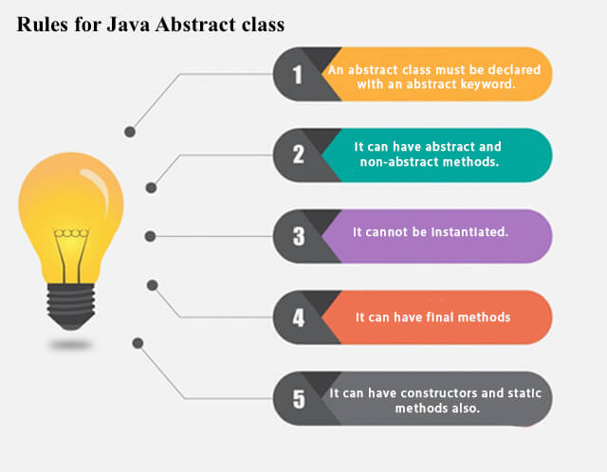

Slide 5
Syntax of Abstract Classes
In Java, abstract classes are defined using the abstract keyword. Here's a basic syntax example:
public abstract class Shape {
// Abstract method
public abstract double area();
// Concrete method
public void display() {
System.out.println("This is a shape.");
}
}
In this example, Shape is an abstract class with one abstract method area() and one concrete method display(). Subclasses of Shape must implement the area() method, but they can inherit the display() method.

Slide 6
Abstract Method in Java
A method which is declared as abstract and does not have implementation is known as an abstract method.
Example of abstract method
abstract void printStatus(); //no method body and abstract

Slide 7
Key Features of Abstract Classes
Abstract Methods: Abstract classes can have abstract methods, which are declared without a body. Subclasses must provide concrete implementations for these methods.
Concrete Methods: Abstract classes can also contain concrete methods with defined behavior. Subclasses inherit these methods along with their implementations.
Cannot be Instantiated: Abstract classes cannot be instantiated directly. They serve as a blueprint for other classes and must be extended to be used.
Can Have Constructors: Abstract classes can have constructors, which are invoked when a subclass object is created. These constructors are used to initialize the state of the abstract class.

Slide 8
Interface in Java
An interface in Java is a blueprint of a class. It has static constants and abstract methods.
The interface in Java is a mechanism to achieve abstraction. There can be only abstract methods in the Java interface, not method body. It is used to achieve abstraction and multiple inheritance in Java.

Slide 9
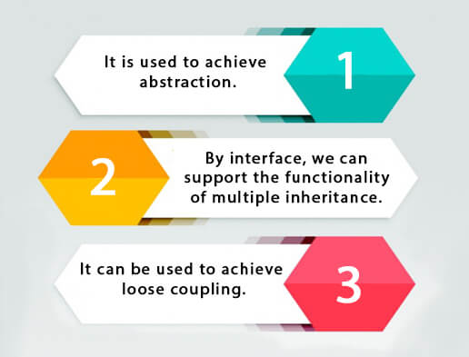
Why use Java interface?

Slide 10
How to declare an interface?
An interface is declared by using the interface keyword. It provides total abstraction; means all the methods in an interface are declared with the empty body, and all the fields are public, static and final by default. A class that implements an interface must implement all the methods declared in the interface.
Syntax:
interface <interface_name>{
// declare constant fields
// declare methods that abstract
// by default.
}
</interface_name>

Slide 11
THANK YOU

